Slide 1
Binarization
Prof.Aruna Malapati

Slide 2
Learning Objective
Apply Binarization
List the issues encountered during binarization

Slide 3
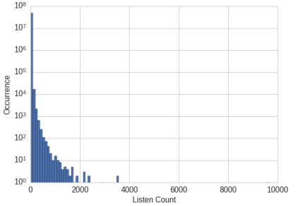

Motivation for Binarization
Echo Nest Taste Profile Dataset:
There are more than 48 million triplets of user ID, song ID, and listen count.
The full dataset contains 1,019,318 unique users and 384,546 unique songs.
Build a recommender system to recommend songs to users.
Larger count means the user really likes the song ?
99% of the listen counts are 24 or lower
Raw listen count is not a robust measure of user taste.
Notes:
One feature of the recommender might predict how much a user will enjoy a particular song. Since the data contains actual listen counts, should that be the target of the prediction?
This would be the right thing to do if a large listen count means the user really likes the song and a low listen count means they’re not interested in it. How‐ ever, the data shows that while 99% of the listen counts are 24 or lower, there are also some listen counts in the thousands, with the maximum being 9,667.
A more robust representation of user preference is to binarize the count and clip all counts greater than 1 to 1. In other words, if the user listened to a song at least once, then we count it as the user liking the song. This way, the model will not need to spend cycles on predicting the minute differences between the raw counts. The binary target is a simple and robust measure of user preference.

Slide 4
Binarization
Binarization maps a continuous or categorical attribute into one or more binary variables.
Must maintain ordinal relationship
Assume an ordinal attribute for representing service of a restaurant: ({Awful,Poor,OK,Good,Great})
Service quality | Integer Value | X1 | X2 | X3
Awful | 0 | 0 | 0 | 0
Poor | 1 | 0 | 0 | 1
Ok | 2 | 0 | 1 | 0
Good | 3 | 0 | 1 | 1
Great | 4 | 1 | 0 | 0
Unintended relationships: X2 and X3 are now correlated because “good” is encoded using both attributes

Slide 5
Binarization
Service quality | Integer Value | X1 | X2 | X3 | X4 | X5
Awful | 0 | 1 | 0 | 0 | 0 | 0
Poor | 1 | 0 | 1 | 0 | 0 | 0
Ok | 2 | 0 | 0 | 1 | 0 | 0
Good | 3 | 0 | 0 | 0 | 1 | 0
Great | 4 | 0 | 0 | 0 | 0 | 1
Binary attributes, where only the presence of 1 is important
One binary attribute for each categorical value
Be Careful: Number of resulting attributes may become too large

Slide 6
Thank You!
In our next session: Proximity measures for binary attributes

